Slide 1

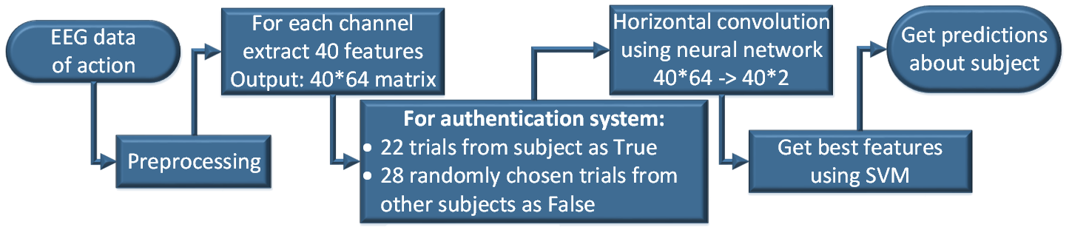
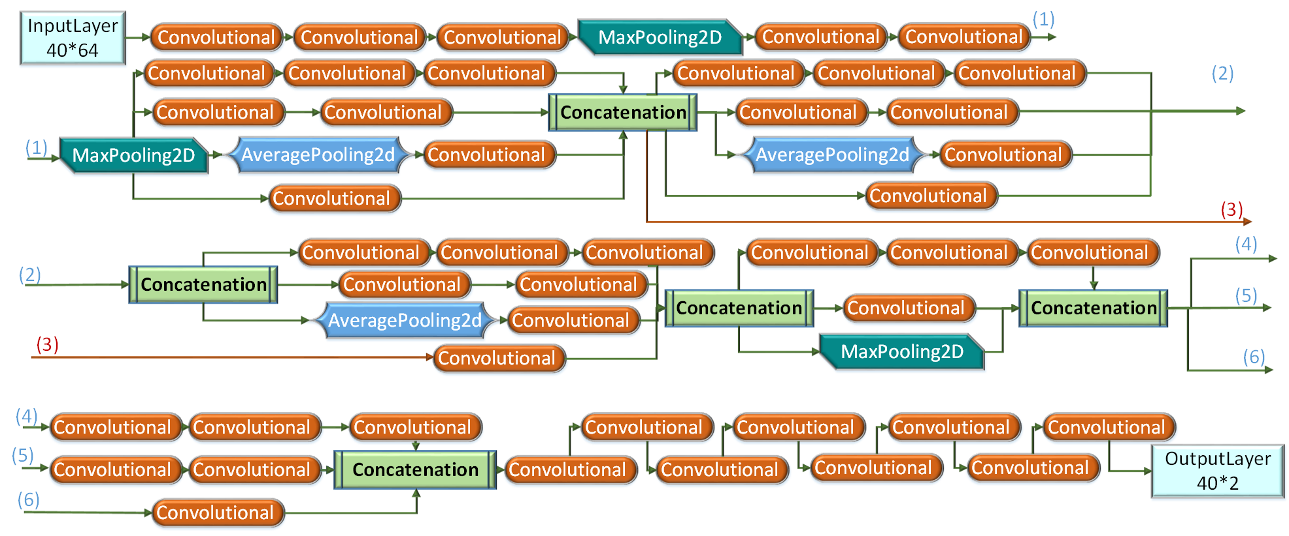
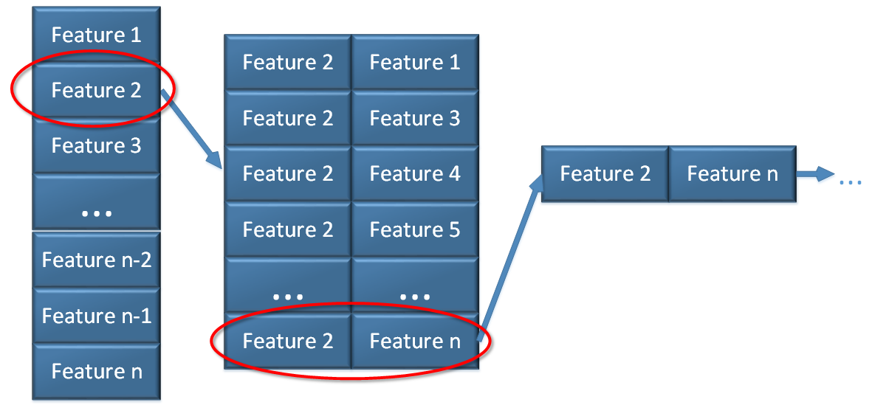
BIOMETRIC AUTHENTICATION SYSTEM BASED ON NEURAL NETWORK PROCESSING FOR EEG DATA
Uladzislau Barayeu, Nastassya Horlava, Pavel Bulai
Belarusian State University, Minsk, Belarus
Introduction
Preprocessing and feature extraction
The task was to build authentication system based on electroencephalography (EEG) Data. The dataset “EEG Motor Movement/Imagery Dataset” from Physionet¹ which contains 105 subjects was used. Subjects performed different motor/imagery tasks while 64-channel EEG were recorded using the BCI2000 system.² Each subject performed 14 experimental runs.
For authentication were used opening and closing right or left fist, and system was separately learned for right, left and both fists.
Data was imported into MATLAB for analysis using custom-written scripts. Before each trial was 2 sec of relax, and this data was used as baseline. Then data was filtered with zero phase delay from 1 to 50 Hz.
2 types of features were extracted:
Frequency of EEG brain activity.
Power Spectral Density (PSD) was calculated with multitaper method on Chronux toolbox³. For each channel 20 frequency bands were chosen from 1 to 40 Hz in log scale, and PSD was extracted.
Entropy of EEG brain activity.
For each trial Empirical Mode Decomposition (EMD) was made with 40 dB resolution and 60 dB residual energy, and only first 5 intrinsic mode functions (IMFs) were left. For each channel and for each first 5 IMFs we have obtained the following entropies: Univariate Shannon entropy, log entropy, Sample entropy, Approximate entropy. ⁴
In total matrix 64 channels*40 features was obtained.
Fig. 1. Learning of authentication system
Neural Network (NN)
Support Vector Machine (SVM)
For horizontal convolution of matrix, NN was build using Keras framework in Python. Its model was based on the “InceptionV3” model⁵ , and had the following structure (figure below).
For training structure of this NN was expanded with the set of Dense layers, and Adam optimization method was used with learning rate 10 ⁻⁴.
After that, data was transformed into 40*2 vector via part of the trained network without Dense layers. Then this vector was transformed into 80*1 for SVM.
After decomposition via NN we have obtained vectors (80*1) which are appropriate for classification via SVM method. With the help of SVM it is possible to get the best group of features for classification. (figure 3)
In comparison to NN, SVM, has an opportunity to rank features.
As a result of this method, the following features were returned as the best for authentication among all subjects: Shannon entropy (1 IMF), Approximate entropy (1 IMF), log energy (1 IMF), and osculation in beta rhythm.
Choose feature with best accuracy
Choose group of features with best accuracy, one by one
Fig. 2. Model of neural network
Fig. 3. Selection of the best group of features via SVM
Accuracy
Conclusion
Accuracy and error Type I, II were calculated for NN with Dense layers and with the combination of NN and SVM. Type II error is the most important for authentication system, because the wrong person should never be authenticated.
Combination of NN and SVM significantly increases the accuracy, and more important that Type II error for the combination of 2 actions equals zero.
Authentication system, based on EEG Motor/Movement activity, was built.
The accuracy of the model using only NN was no less than 90%. The probability of type I error was no more than 20%, while the probability of type II error was 1% for the combination of 2 actions. The fact that the type II error was that low suggests that the system is suitable for authentication.
Furthermore, accuracy of the combination of NN and SVM showed even better results, reaching 96%, and Type II error for the combination of 2 actions equals zero.
The method of ranking high dimensional set of features was developed, which uses the combination of NN and SVM.
In future we are planning to build new NN only for selected features, because it should increase accuracy and decrease complexity of NN, which will lead to faster learning process.
 | Right fist | Left fist | Both fists
Type I error | 0.1287 | 0.0757 | 0.2045
Type II error | 0.0595 | 0.0476 | 0.0119
Overall accuracy | 0.91 | 0.94 | 0.9033
 | Right fist | Left fist | Both fists
Type I error | 0.0167 | 0.02 | 0.0367
Type II error | 0.0133 | 0.02 | 0.0
Overall accuracy | 0.97 | 0.96 | 0.9633
Table 1. Accuracy of NN
Table 2. Accuracy of the combination of NN and SVM
References
1 Schalk, G., McFarland, D.J., Hinterberger, T., Birbaumer, N., Wolpaw, J.R. BCI2000: A General-Purpose Brain-Computer Interface (BCI) System. IEEE Transactions on Biomedical Engineering 51(6):1034-1043, 2004.
2 http://bci2000.org
3 http://chronux.org
4. Tonoyan, Yelena, et al. "Discriminating multiple emotional states from EEG using a data-adaptive, multiscale information-theoretic approach." International journal of neural systems 26.02 (2016): 1650005.
5. Szegedy, Christian, et al. "Rethinking the inception architecture for computer vision." Proceedings of the IEEE conference on computer vision and pattern recognition. 2016.

